Slide 1

Improving ABA Services Through Resource Allocation
Minji Woo, Ayush Suri, Evan Wacks, Nishant Aggarwal, Ahmad AlQemzi, Jake Gale

Slide 2
Questions
Accessibility
2. Efficiency
Are human resources used effectively?
Can we increase efficiency by pre-training the human resources about high-demand questions?
Are clients’ questions getting answered?
Is the service equally available for each state?
Notes:
Accessibility
Are clients’ questions getting answered?
Is the service equally available for each state?
Efficiency
Are human resources used effectively?
Can we increase efficiency by pre-training the human resources about high-demand questions?

Slide 3
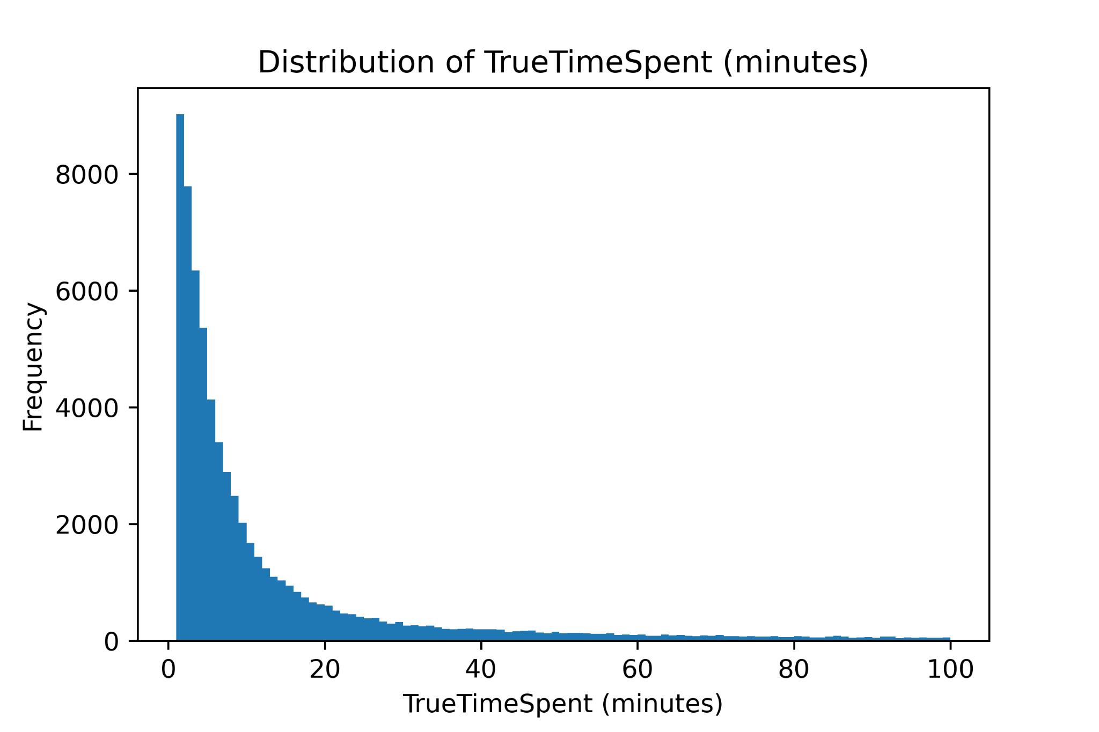
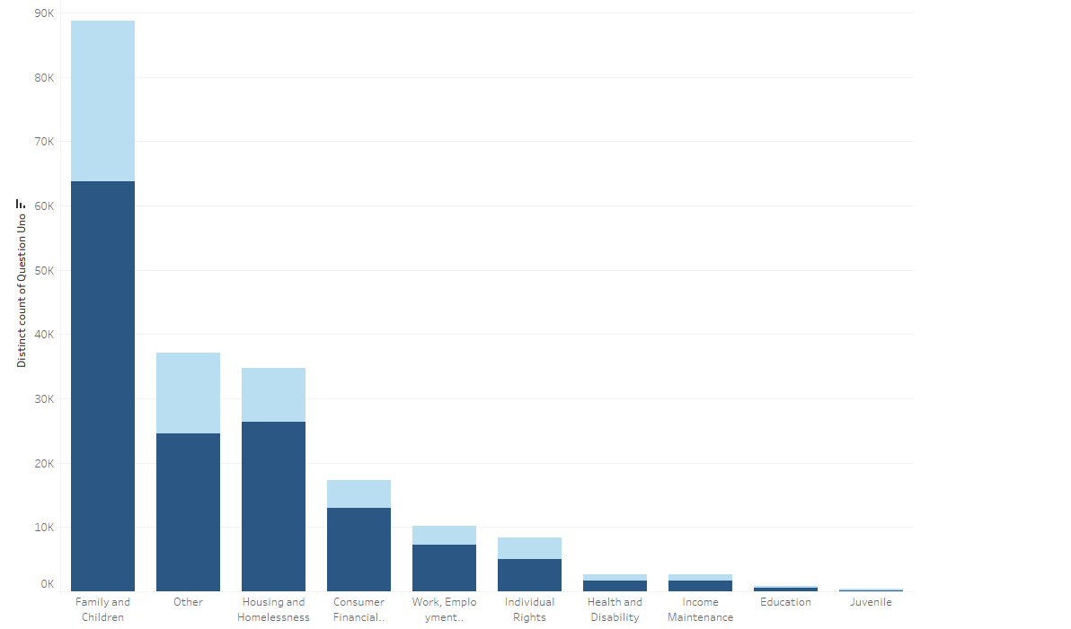
Response Time Efficiency
Distribution of True-Time Spent on Questions
Mean Conversation Length: 18.31 days
Median Conversation Length: 10.8 minutes
58% of questions resolved within 20 minutes
Conclusions
Short-End: FAQ, Chatbox, Paralegals, Interns, etc
Long-End: Reference other services
Notes:
True Time = time between attorney taking on a question and their last chat log, telling us the amount of time the attorneys actually spent on the case-- eliminating the dead time that may come on either ends of the conversation.
Difference between mean and median: Mean was 18.31 days, median was 10.8 minutes
58% of the Questions are resolved within 20 minutes, and no significant difference in category or subcategory between shorter and longer conversations
Conclusions: all categories could benefit from (on slides), with emphasis being on the most popular categories. For conversations exceeding a certain threshold, could be more efficient to recommend clients take on another program to speak directly with a lawyer
This means that these problems do not necessarily need an Attorney to be solved. They could be either solved by simply having more enhanced FAQ, or by having a paralegal or intern answer these questions instead (The ones they deem tough/long would be passed down to an attorney). This would help reallocate resources appropriately, give attorneys more time to analyze more complex cases, and save money (paralegal's salary is less than attorney's salary), while also helping people gain experience in the field!

Slide 4
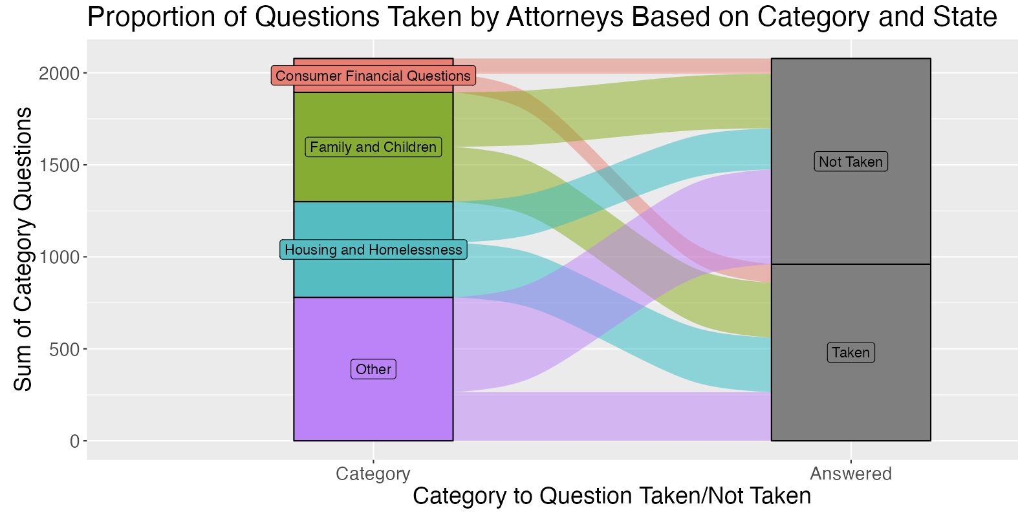
Unanswered Questions
Distribution of Unanswered Questions
In California we see many cases are not taken
But how do we counter that at State level?
Potential Solution:
Case grouping when high influx of cases”
Attorneys read through multiple cases in same subcategory / category and send out broader answers
Opportunities for individual questions should they arise

Slide 5
Conclusions
Notes:
Limitations
What about people in Debt?
How can we address the systemic issues that arise with the law?
Problems with the people the law is meant to serve not being easily understood
Resource allocation
Hire Paralegals and interns to take shorter cases in states with high case per attorney ratios
Investigate the “Other” Category and create new issue categories
Many Other questions pertain to family
Have attorneys Focus on specific categories
Case Grouping
Spend time to group similar questions and then

